Slide 1


2022
END OF THE
YEAR REVIEW

Slide 2

Content
Letter from the partners
Projects we had the pleasure to work with
Success cases
Consortiums
New Team Members
Last thoughts of 2022 and hopes for 2023

Slide 3

01
Letter from managing partners
2022 – a year of extremes.
A challenging year comes to an end, with many global crises that were felt in the Western world and at our offices in Inveniam. The unnecessary and unjust war in Ukraine, coming on the back of the global pandemic, has brought a rethink of the global collaboration process disrupting the Energy, Agrifood and Raw materials markets as many countries see a more insular future.
Meanwhile in the Mediterranean we have suffered the hottest summer reaching records of extreme temperatures (especially at night) in successive waves. Climate change is not something that will occur in 2050, or only affect rare ecosystems or remote islands in the Pacific. It is a clear threat for all of us. It's here and now. Yet the political response is weak.
Insular approaches cannot solve global challenges. Against this backdrop of geopolitical conflict and competition, research and innovation continues to be led by collaborative efforts to solve the multiple threats to our society, economy and environment.
Possibly the most important scientific results of 2022 came just a few days ago in the United States, with the first ignition event, the holy grail in nuclear fusion technology.
When Alain Bécoulet, Head of Engineering at ITER, an international nuclear fusion research project in France, was asked how he felt about the success of his competitors he replied, “extremely happy…it is extremely important news for all the community and, believe me, for mankind.”
2022 will be remembered as a year when the global energy, supply chain, climate change and medical challenges were felt in every home across the world. While the geopolitical response to these challenges is to fracture, putting the world at risk, researchers from around the world are collaborating to solve these problems.

Slide 4
Our Brains Are Open
Inveniam’s role is to bring people together, to make collaborations happen and open the pathway to the market for the research and innovation that can offer a response to these threats.
2022 has seen us coordinate our first European funded project, BioBoost, that looks to provide Project Development Assistance to innovative circular economy projects in Catalonia, with the aim of leveraging 100M€ of investment in these projects. We also participate in the SEMPRE-BIO project, demonstrating novel pathways to provide BIOmethane. This sustainable energy vector is fully aligned with REPower– EU initiative to foster a local, secure and sustainable source of energy across Europe.
In the Life Sciences field, we now go beyond healthcare, to open roads into the food-tech and the biotech field on all its applications. We have expanded our capabilities as a specialized strategic advisory firm with new services to offer our startup and SME clients the insights of Market Access services such as Health Economics with Cost Effectiveness and Willingness to Pay studies that in the past were reserved only to affluent corporate firms.
We have also continued to support European partners (from the Technion, Israel Institute of Technology to the Centre for Genomic Regulation in Barcelona) to build and win European funded collaborative projects, raising over 40M€, and with 90% of our proposals reaching the interview stage of the EIC accelerator. Furthermore, we have also closed two financing rounds for cardiology startups (Ivestatin and Nimble) with disruptive value propositions and relevant impact.
To achieve these goals, we are grateful to our incredible team of professionals and advisors. At the organization level, we have built a more efficient workflow in different areas such as Project Management, Knowledge Management and Accounting and Finance. Our flagship R&D project Invesplora has helped us to introduce new digitalization tools, for the first time using Artificial Intelligence to improve workflows and internal processes. We have grown as a team for the third year running, bringing on board gifted professionals to broaden our capabilities. We have seen our employees mature to managerial positions, leading projects and organizational change within Inveniam.

Slide 5

2023 – challenges and opportunities
It is clear that geopolitical and economic conditions will continue to create a complicated environment for investors and business in general in 2023. In these circumstances, it is essential that researchers continue to collaborate at an international level to make the vital changes that are essential to the survival of our societies and our planet. Signs are positive: 2023 will see the first EU funded health projects with American organisations. Inveniam will also be part of a project, led by Sant Joan de Deu hospital to develop a pan-European Paediatric Innovation Ecosystem.
At Inveniam we will continue to foster these collaborations, and we are grateful to all our colleagues and partners for supporting us in this mission as we move into 2023.
Eric Suñol, Elena Canetti, John Crockett, Albert Cot y Alex Fuentes

Slide 6





02
Projects we worked with in 2022
Ivestatin is building a long-lasting relationship with Inveniam with the view to convert an idea into a first-in-class product. And now, thanks to Inveniam support and knowledge, Ivestatin is starting the path to success.
The year 2022 was Innomy's year of consolidation. We managed to form important alliances and close a crucial investment to take off as a startup. It would not have been possible without the support and network of Inveniam, so we are very grateful for their management, and we are confident that we will continue working together. A team of professional people who accompanied us at all times.
Inveniam has been an invaluable partner throughout the years, but in 2022 they stepped up and helped us both in public and private fundraising endeavours when we most needed it to capitalize on NIMBLE’s large and exciting opportunities. First, Inveniam has supported us in the writing and submission of national and European public grant calls and then by accompanying us during our first capital raise round both by connecting NIMBLE to the right partners and investors and by making us feel comfortable along the way. We are surely looking forward to continue having Inveniam as our journey’s partner and we are eager to collaborate in future projects and developments.
The Technical Secretary of MES BARCELONA would be unable to function effectively without the assistance of Inveniam. It is an essential component of the project in terms of optimizing the size of photovoltaic facilities as well as their financial viability, among many other contributions

Slide 7






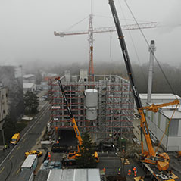

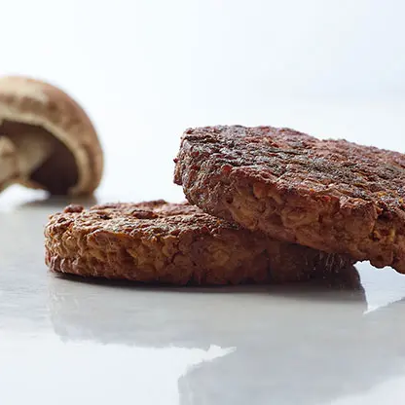



03
Some Relevant Success Cases in 2022
TECSAM
ITEMAS
Ajuntament de Barcelona
Mentoring members of the Mental Health Network
consultoring
Technical and Financial Consulting
WtEnergy
Innitius
Innomy
Private Fundraising
Public Funding & Private Funding
Private Fundraising
3.8M€
1.3M€

Slide 8

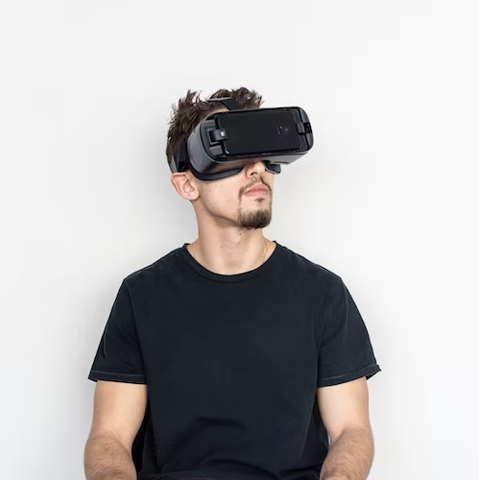


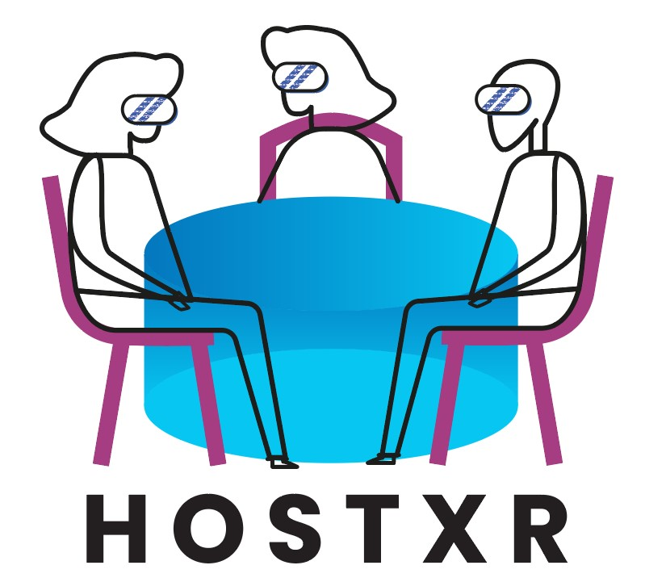




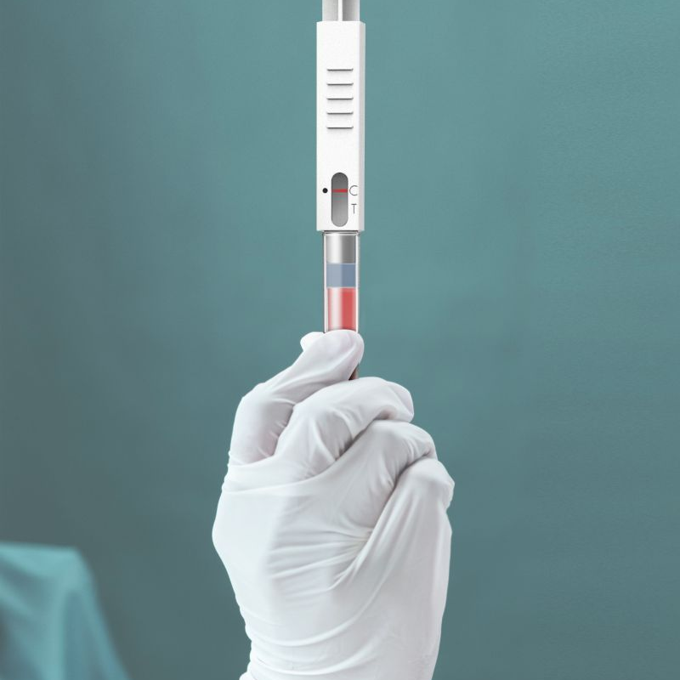

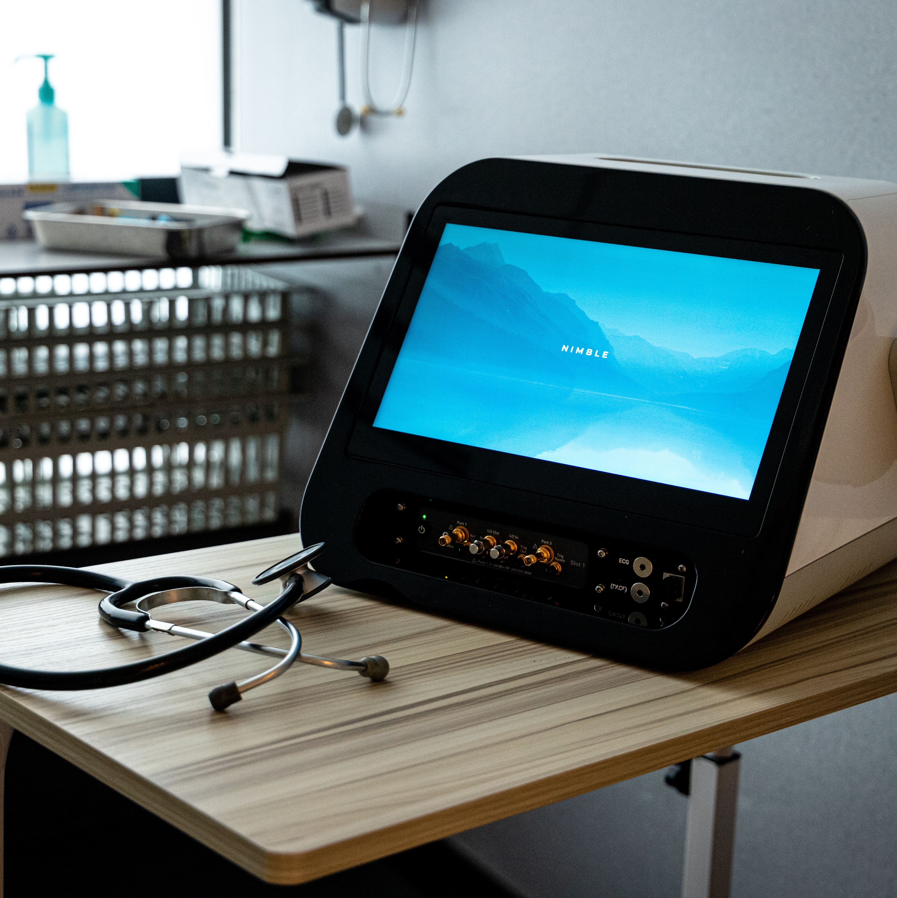


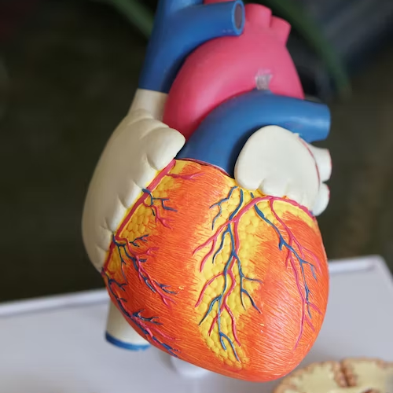

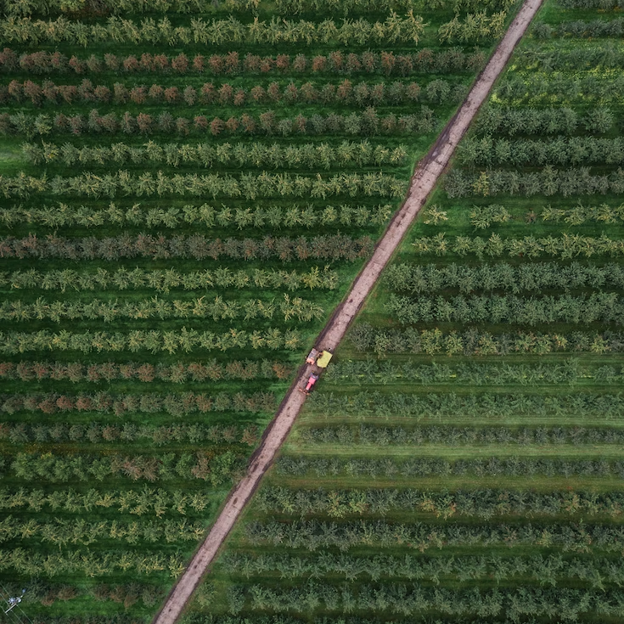

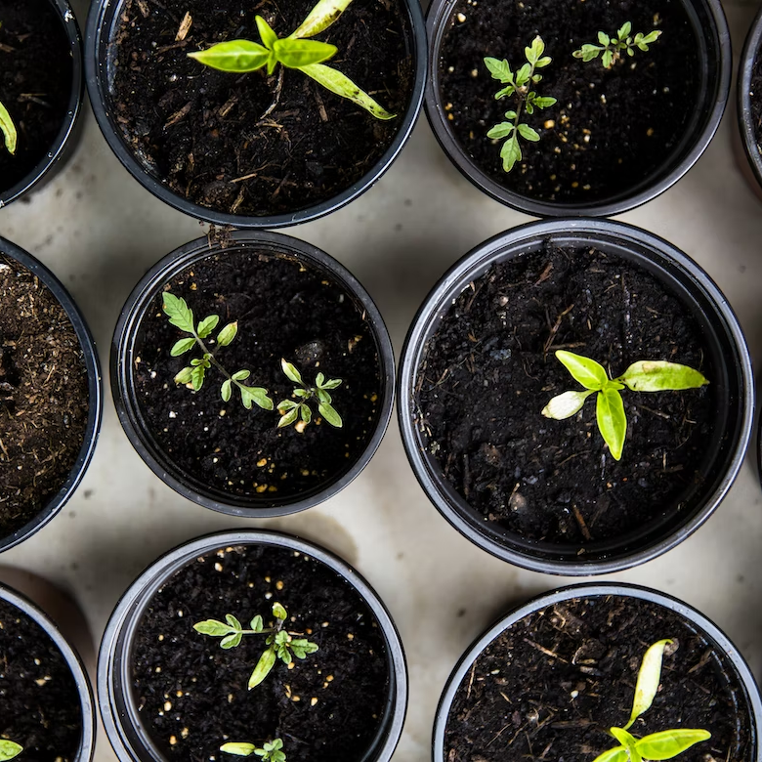

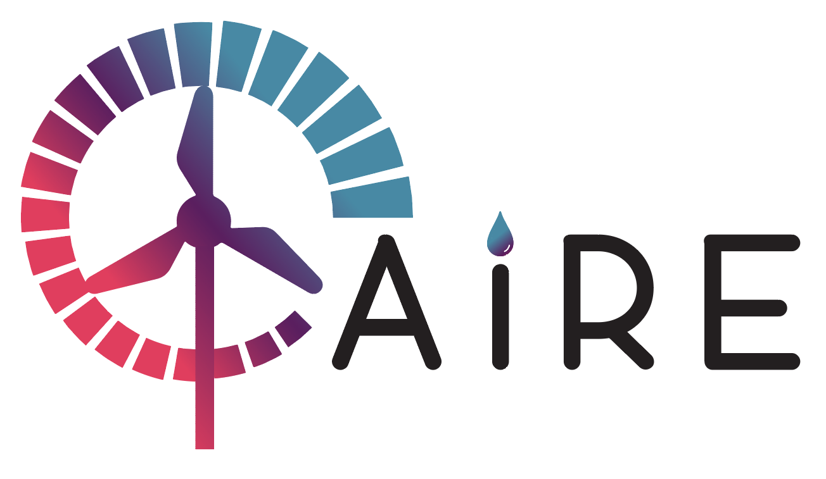

Gate2Brain
Guest XR Consortium
TAONas-LUAD Consortium
Public Funding
Public Funding
Public Funding
2.5M€
4M€
3M€
SafeWax
Public Funding
xM€
Loop DX
Zebra Life Consortium
Nimble Diagnostics
Public Funding
1.2M€
Public Funding
Private Funding
Ivestatin Therapeutics
2.8M€
1M€
Private Fundrasing
xM€
Sempre Bio Consortium
Aire Consortium
BioBoost Consortium
Public Funding
Public Funding
Public Funding
10M€
6M€
1.8M€

Slide 9
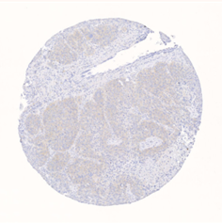
04
Collaborative projects that started in 2022
TAONas-LUAD
Inveniam is honored to be a partner of the TAONas-LUAD EIC Transition consortium with CRG (Centre for Genomic Regulation), SINTEF (Applied research, technology and innovation, Norway), and INSERM (Institut national de la santé et de la recherche médicale, France).
The TAONas-LUAD project aims to develop an innovative therapy based on the use of Antisense Oligonucleotides (AONs) that regulate alternative splicing (AS) to target a pro-proliferative protein isoform observed in the vast majority of Lung adenocarcinomas (LUAD) tumors. The technology developed by Dr. Juan Valcarcel and Dr. Jordi Hernández at CRG will be adapted for non-viral lipid nanoparticles delivery by Dr. Sven Even Borgo’s group from SINTEF and validated in vivo using lung cancer xenographs models at Dr. Antonio Maraver’s lab from INSERM. Inveniam Group will support the implementation of the market and business strategy of the project. We will also collaborate on defining the project’s regulatory roadmap and communication strategy.
https://taonas.eu
BioBoost
Inveniam Group is proud to announce the start of the BIOBOOST consortium. Inveniam will serve as project coordinator along with our partners Simbiosy, Aeris Environmental Technologies, and Roca Junyent. BIOBOOST is a project that is financed by the European Commission under the Circular Cities and Regions Initiative (CCRI) and has the main objective of catalyzing investments for the development of Bioeconomy projects in the Catalonia region.
BIOBOOST provides technical-economic support to industries, entities, and promoters who wish to develop projects to improve the use of natural resources, industrial symbiosis, and circular economy.
BIOBOOST provides Project Development Assistance (PDA) for Bioeconomy Projects. These services include technical, economic, and legal advice on promoting projects to use biological resources in the agricultural and industrial sectors, such as energy recovery projects or waste materials and circular economy. BIOBOOST wants to create a model of good practices that can be replicated in other regions.
https://bioboost.cat/en/

Slide 10



ZEBRA-LIFE
We are proud to be part of the project consortium together with Centro Nacional de Energías Renovables (CENER) – National Renewable Energy Centre, Smurfit Kappa, ASINCAR, CENTRO TECNOLOGICO RIOJANO SA, Roka Furadada, Repsol and Bioquochem (BQC redox technologies). ZEBRA-LIFE, is an European research LIFEproject funded by the LIFE programme, the EU’s funding instrument for the environment and climate action.
The project has the aim to transform the black liquor from the pulp and paper industry waste into sustainable lignin-derived bio-aromatics for the cosmetic, food, fuel, and lubricants, and polymer industries. Thus to create a new circular value chain that fits into the European Circular Economy Action Plan.
SempreBio
Inveniam is honored to be a partner of the Sempre Bio consortium with Cetaqua, Centro Tecnológico del Agua, Aigües de Barcelona, Naturgy, Cryo Inox, Propuls from Germany, TerraWatt from France, Innolab and NV De Zwanebloem from Belgium; the Metropolitan Area of Barcelona as a public entity; the research centers DBFZ from Germany, SINTEF from Norway,
and Biogas-E, from Belgium. From academia, the Technical University of Denmark, the University of Ghent in Belgium, and the BETA Technological Center of the UVic-UCC in Spain will participate.
The SEMPRE-BIO project, led by Cetaqua, water technology center, has recently been launched to demonstrate new cost-effective biomethane production solutions. This initiative will seek to reduce the investment and operating costs of biomethane production plants and extend the biomethane production potential through new waste valorization routes. Likewise, SEMPRE-BIO will also propose alternative monetization sources, such as the valorization of biogenic CO2 or the commercialization of biochar.

Slide 11
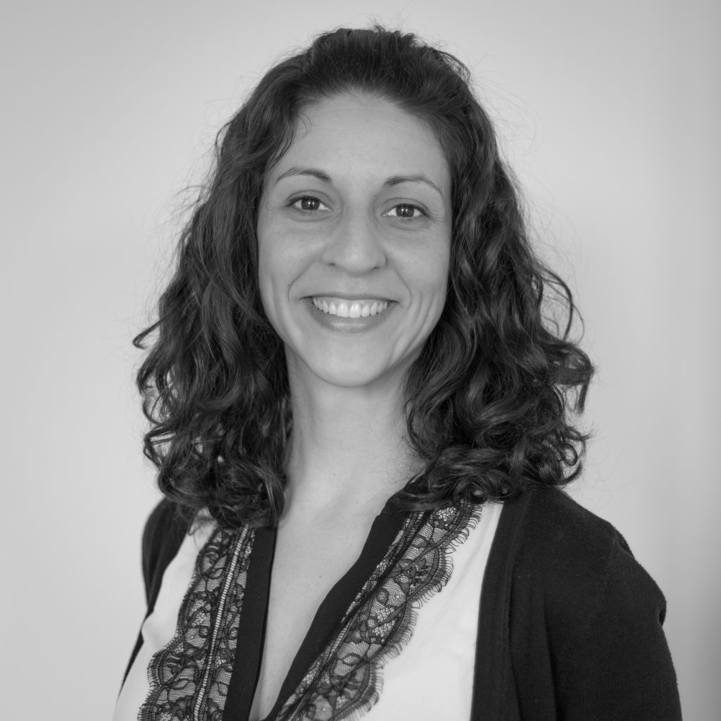
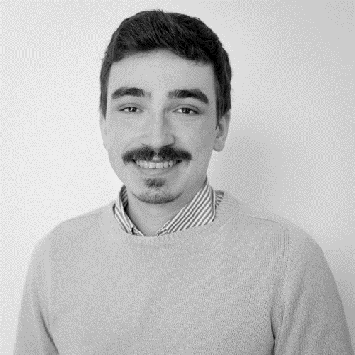
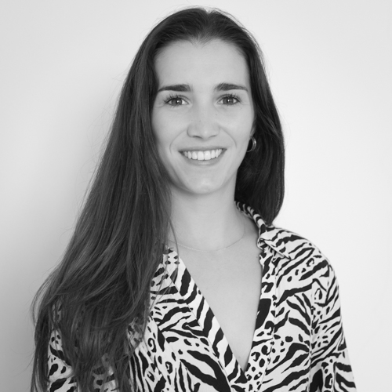
05
New Team members
Miriam
Romero
Associate
Landed six months ago but already feeling like part of the Inveniam family: a great work environment, a fantastic human team plus a heap of innovative projects make the perfect welcome. Eager to start all the new coming projects and be part of the gamechangers that will make possible a sustainable future.
Guillermo
Llamas
Analyst
Working at Inveniam is to belong to a great human group in which more than colleagues, we form a big family with the aim of helping to achieve a better world. Work, effort and sacrifice are the pillars that drive this group of professionals.
Júlia
Gómez
Analyst
Taking part in the Inveniam team is a rewarding experience. The welcoming environment and teamwork values have made it possible to take steps towards the energy transition

Slide 12
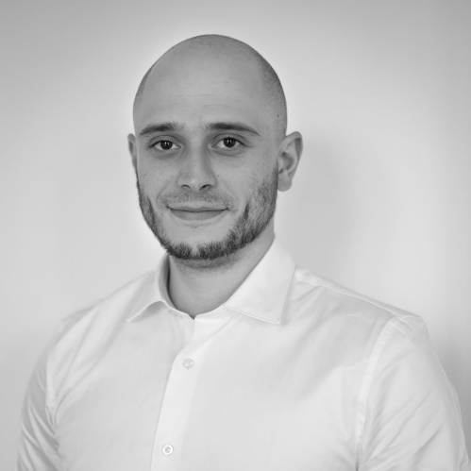
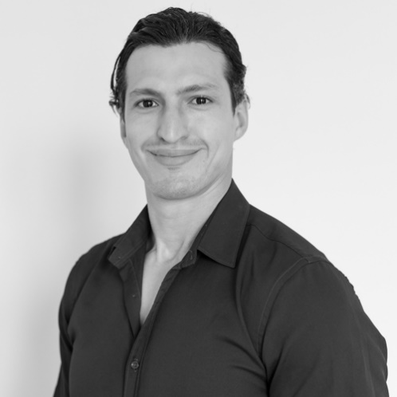
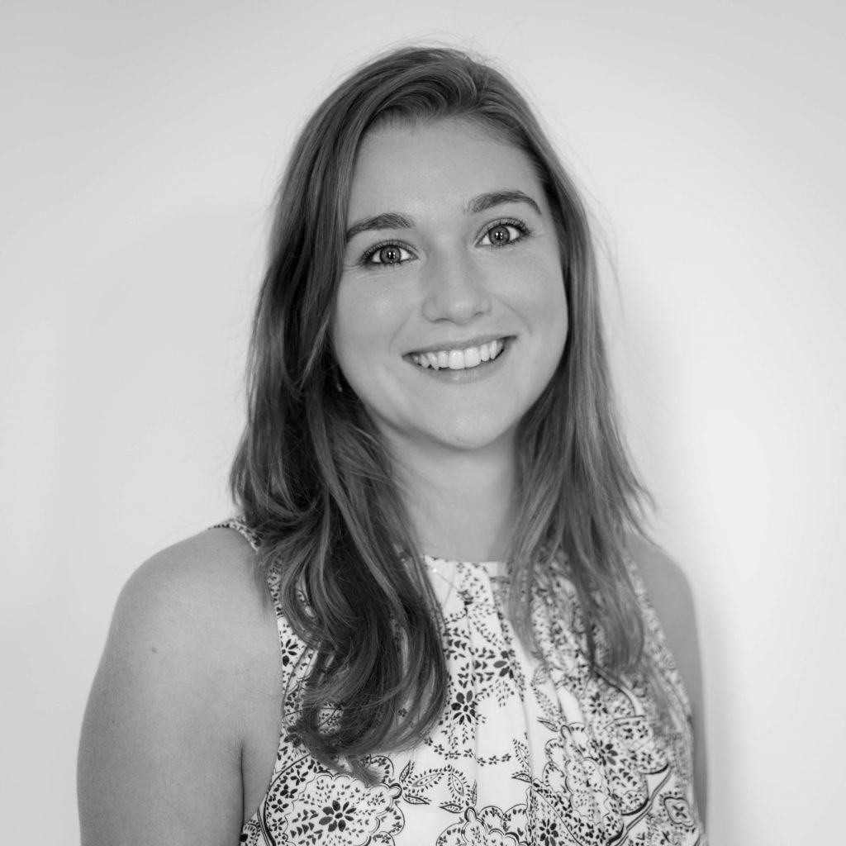
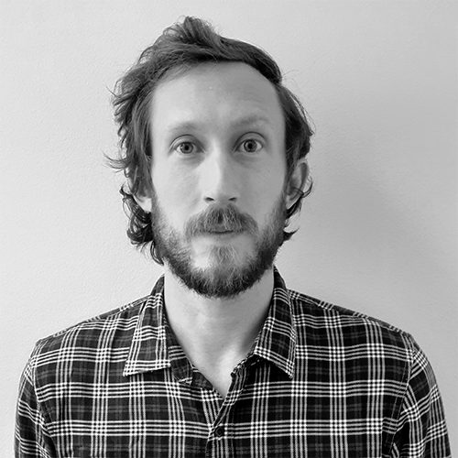
Joaquim Comes
IT Manager
In less than a year, I have worked on artificial intelligence and digitalization projects around the organization, while also being part of a team with a lot of skill and promise that makes you feel like part of the family.
Nazih
Toubal
Analyst
It has been an absolute honor to work with the team last year, looking forward to the next!
"Last year was about reaching goals, this year is about going beyond them"
Fé Van de Broek
Analyst
Inveniam has created a dynamic and collaborative environment that helps you thrive, giving you both the responsibility and support needed to develop your skills and build new ones. For the next year, I hope to further grow by overcoming new challenges and deepening my understanding of the Life Sciences startup ecosystem in Europe.
Jacob Hyer
Analyst
My immersion into the roiling waters of biotech innovation has been both challenging and thoroughly enjoyable. In the coming year, I will be even more equipped to help others chart a course for success.

Slide 13
06
Challenges for the year 2023
ESG Impact monitoring
At Inveniam we do not only focus on identifying the operations which have an environmental and social impact but we also support our clients on these impact quantification.
Investing in a sustainable manner also means investing on the future. The companies who look to solve the biggest challenges in the world can be better positioned. We advise companies with the aim to generate a measurable environmental and social impact at the same time it allows them to grow and generate financial profit.
The sustainable assets under management represents already a quarter of the world’s total assets, representing 35 billion dollars in 2020 (Credit Suisse). In addition, according to the research “ESG factors impacting on the cost-effectiveness-risk relation” carried out by the Spanish Financial Analyst Institute, concludes that “the consideration of sustainability aspects improves the portfolios cost-effectiveness-risk ratio”.
Our target is to monitor sustainable projects and their social and environmental positive impacts. Hence, contributing to the UN’s Sustainable Development Goals
at the same time they generate interesting returns to the investors.
Finally, our challenge for 2023 will be to create a positive impact infrastructure’s monitoring system that allows the measurement and real-time monitoring of:
Tons of GHG emission avoided (CO2, SOx, NOx and PM10)
Cost saving on health services thanks to the reduction of GHG emissions which have a negative impact on human health such as the development of cardiovascular, cardiorespiratory, or skin cancer diseases among others.
Cost savings over the fight against climate change
Cost savings due to fossil resources non-dependency
Employment generation
Among other positives impact in multiples field
With this system we hope to promote the public awareness about the environmental and social advantages of implementing positive impact projects.

Slide 14

Last thoughts of 2022 and hopes for 2023
06
2022 was a year where we achieved important milestones, we kept growing together as a company and we pushed our limits to overcome big challenges.
These achievements are only possible with the fantastic collaborations that we are part of, and we would like to thank you for your support to Inveniam Group and for helping us to grow this year.
2023 promises more challenges and more opportunities and we look forward to working with you to continue to foster collaborative partnerships and to bring breakthrough technologies to the market for a more sustainable, healthier world.
www.Inveniam-group.com

Slide 15
CREATING NEW PATHWAYS FOR YOUR JOURNEY

